Slide 1


Open Science And Reproducibility
Alexandra Sarafoglou
Myrthe Veenman
Onderwijs Research Dagen 2019

Slide 2

Open Science and Reproducibility
Outline
Confirmatory versus Exploratory Research
Practical Tools to Increase Transparency
Preregistration and Analysis Blinding
Teaching Good Research Practices: Student Perspective
Onderwijs Research Dagen 2019
Alexandra Sarafoglou

Slide 3
Confirmatory versus
Exploratory Analysis
Disclaimer
Slides on Confirmatory versus Exploratory Research were taken from Eric-Jan Wagenmakers TeaP talk on the reproducibility crisis and future prospects of transparent research practices.
His talk is available at: https://www.youtube.com/watch?v=LxRHkk2MBWw&t=365s
Onderwijs Research Dagen 2019
Alexandra Sarafoglou

Slide 4
Confirmatory versus
Exploratory Analysis
Using the Data Twice
There is a conceptual distinction between hypothesis-generating and hypothesis-testing research (De Groot 1956/2014; Reichenbach, 1938)
When the data inspire a hypothesis, you cannot use the same data to test this hypothesis
Onderwijs Research Dagen 2019
Alexandra Sarafoglou

Slide 5
Confirmatory versus
Exploratory Analysis
Old Knowledge & Old Data
Poppers
disconfirmability
test
The Empirical Cycle
knowledge accumulation
speculate
& explore
Evaluation
New Hypothesis
The Statistical Context of Justification – Confirmatory Research
fooling
yourself
The Creative Context of Discovery – Exploratory Research
statistical analysis
deduce
Test on New Data
New Prediction
design
new
experiment
Onderwijs Research Dagen 2019
Alexandra Sarafoglou

Slide 6
Confirmatory versus
Exploratory Analysis
Why multiple testing matters
Exploratory analyses introduce a multiple comparisons problem which increases the Type-I-error rate
Maximum allowable probability to make a Type-I-error is ⍺ (typically ⍺ = 0.05)
P(not making an error) = 1 - ⍺
P(not making an error in m tests) = (1 - ⍺)^{m}
P(making at least one error in m tests) = 1 - (1 - ⍺)^{m}
Onderwijs Research Dagen 2019
Alexandra Sarafoglou

Slide 7
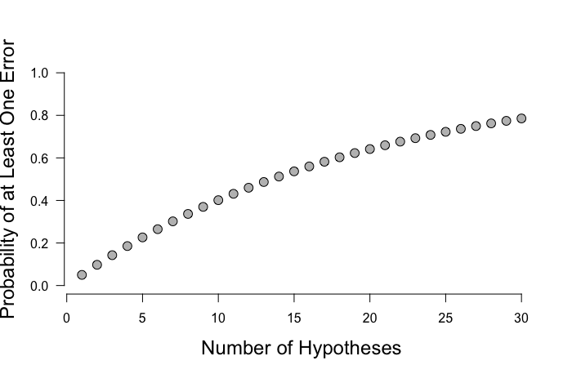
Confirmatory versus
Exploratory Analysis
Why multiple testing matters
Trying out m = 5 different analyses:
1 - (1 – 0.05)⁵ = 0.23
Probability to make at least 1
Type-I error in 5 tests is 23%.
Onderwijs Research Dagen 2019
Alexandra Sarafoglou

Slide 8
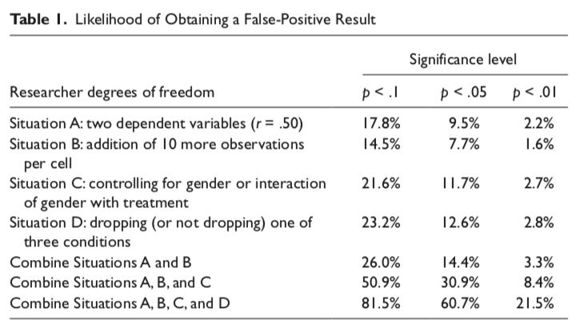
Confirmatory versus
Exploratory Analysis
Why multiple testing matters
Simmons, Nelson, Simonsohn (2011)
Onderwijs Research Dagen 2019
Alexandra Sarafoglou

Slide 9
Confirmatory versus
Exploratory Analysis
Why multiple testing matters
If the tests are informed by the data, they lose their predictive interpretation, and, with it, their statistical validity
Exploratory analyses introduce a multiple comparisons problem which increases the Type-I-error rate
→ Statistical tests are only appropriate for purely confirmatory research efforts
Onderwijs Research Dagen 2019
Alexandra Sarafoglou

Slide 10
Confirmatory versus
Exploratory Analysis
Solutions
Be transparent about your research methods and study design
Specify your hypotheses and your analysis plan before you start data collection
Exchange experiences with peers (e.g., through an Open Science Community)
Start small: incorporate good research practices in your student projects and teaching
Onderwijs Research Dagen 2019
Alexandra Sarafoglou

Slide 11
Confirmatory versus
Exploratory Analysis
Solutions
Be transparent about your research methods and study design
Specify your hypotheses and your analysis plan before you start data collection
Exchange experiences with peers (e.g., through an Open Science Community)
Start small: incorporate good research practices in your student projects and teaching
Onderwijs Research Dagen 2019
Alexandra Sarafoglou

Slide 12
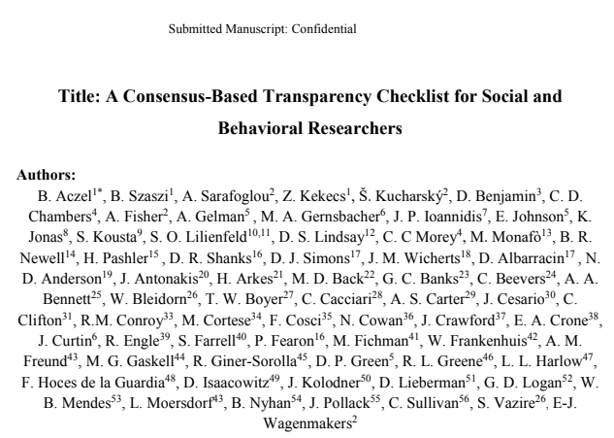
Transparency
Transparency Checklist
Created by open science advocates and editors from leading psychology journals
https://eltedecisionlab.shinyapps.io/TransparencyChecklist/
Onderwijs Research Dagen 2019
Alexandra Sarafoglou

Slide 13
Confirmatory versus
Exploratory Analysis
Solutions
Be transparent about your research methods and study design
Specify your hypotheses and your analysis plan before you start data collection
Exchange experiences with peers (e.g., through an Open Science Community)
Start small: incorporate good research practices in your student projects and teaching
Onderwijs Research Dagen 2019
Alexandra Sarafoglou

Slide 14
Preregistration
Solutions
Specify your hypotheses and your analysis plan before you start data collection
Preregistration (Registered Reports; over 200 participating journals!)
https://cos.io/
Onderwijs Research Dagen 2019
Alexandra Sarafoglou

Slide 15
Preregistration
Solutions
Specify your hypotheses and your analysis plan before you start data collection
Preregistration (Registered Reports; over 200 participating journals!)
Onderwijs Research Dagen 2019
Alexandra Sarafoglou

Slide 16
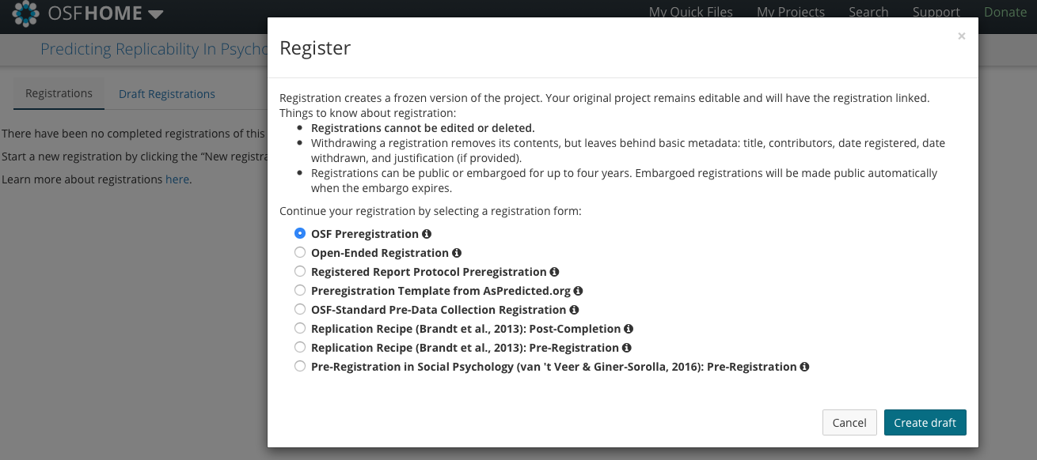
Preregistration
Challenges
Specify your hypotheses and your analysis plan before you start data collection
Preregistration (Registered Reports)
Problem: Not clear what should be included in the preregistration
https://osf.io/
Onderwijs Research Dagen 2019
Alexandra Sarafoglou

Slide 17
Preregistration
Challenges
Specify your hypotheses and your analysis plan before you start data collection
Preregistration (Registered Reports)
Problem: Hypotheses and analysis plan are often too vague
Onderwijs Research Dagen 2019
Alexandra Sarafoglou

Slide 18
Preregistration
Challenges
Specify your hypotheses and your analysis plan before you start data collection
Hypotheses and Analysis Plans are Ambiguous
Example: “Are soccer referees more likely to give red cards to players with dark skin than to players with light skin?”
Chi-square test? Logistic regression?
How do you measure ‘dark’ and ‘light’ skin? Dichotomous factor or multiple levels?
Would you control for the referees skin color?
Would you treat each red-card decision as an independent observation?
Would you try to control for the seniority of the referee?
Onderwijs Research Dagen 2019
Alexandra Sarafoglou

Slide 19
Preregistration
Challenges
Specify your hypotheses and your analysis plan before you start data collection
Crucial Information is Missing
Are you testing assumptions? What will you do if assumptions are violated?
How do you measure your dependent variable? (Example: “classical music improves attention”)
Q |  |  | Q
 | Q
 |  | Q |  | Q
Q |  |  | O
Onderwijs Research Dagen 2019
Alexandra Sarafoglou

Slide 20
Preregistration
Challenges
Specify your hypotheses and your analysis plan before you start data collection
Analysis Plans Have Not Been Tested
Create dummy data! (or use data from an similar study/pilot study)
Try out your analysis (does your analysis plan actually work?)
Ask for feedback for this analysis
Onderwijs Research Dagen 2019
Alexandra Sarafoglou

Slide 21
Preregistration
Challenges
Specify your hypotheses and your analysis plan before you start data collection
Time pressure and Unexpected Features of the Data
Onderwijs Research Dagen 2019
Alexandra Sarafoglou

Slide 22

Preregistration
Challenges: Unexpected Features of the Data
Dutilh et al. (2017)
Preregistration of an impossible analysis
Reproducibility project:
Cancer Biology
Horrigan (2017)
Spontaneous tumor regressions
Arid, Kandela & Mantis (2017)
Unexpected early deaths in control group
Onderwijs Research Dagen 2019
Alexandra Sarafoglou

Slide 23
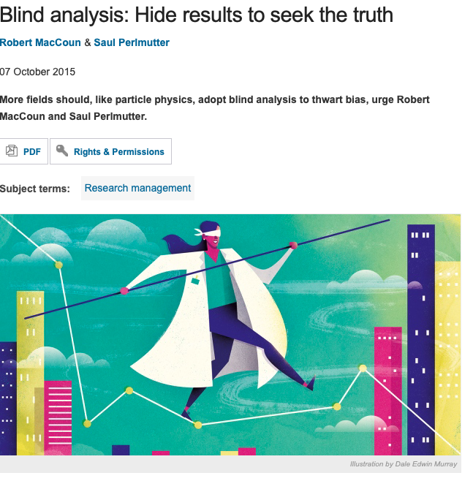
Blinded Analysis
Blinded Analysis
Common practice in (Astro)physics
Allows you to make data-dependent choices without introducing bias
MacCoun & Perlmutter (2015)
Onderwijs Research Dagen 2019
Alexandra Sarafoglou

Slide 24


Blinded Analysis
How does Blinding work?
Experimenter collects data
Data is blinded
Onderwijs Research Dagen 2019
Alexandra Sarafoglou

Slide 25


Blinded Analysis
How does Blinding work?
Experimenter gives the hypotheses and blinded data to analyst
Analyst decides on analysis plan
Onderwijs Research Dagen 2019
Alexandra Sarafoglou

Slide 26


Blinded Analysis
How does Blinding work?
Analyst gives analysis plan to experimenter
The blind is lifted
Onderwijs Research Dagen 2019
Alexandra Sarafoglou

Slide 27

Blinded Analysis
Analysis plan is mechanically conducted on the original data
Onderwijs Research Dagen 2019
Alexandra Sarafoglou

Slide 28
Blinded Analysis
Different Research Designs Demand Different Blinding Methods
e.g., Regression
# Facebook Friends | Amygdala Size | Gender | Age | Overal Brain volume
190 | 0.655 | male | 28 | 1238
232 | 0.680 | male | 35 | 1386
84 | 0.647 | female | 18 | 1176
311 | 0.698 | male | 20 | 1172
138 | 0.699 | female | 27 | 1185
356 | 0.732 | female | 34 | 970
Onderwijs Research Dagen 2019
Alexandra Sarafoglou

Slide 29
Blinded Analysis
Different Research Designs Demand Different Blinding Methods
e.g., Regression
# Facebook Friends | Amygdala Size | Gender | Age | Overall Brain volume
84 | 0.655 | male | 28 | 1238
356 | 0.680 | male | 35 | 1386
190 | 0.647 | female | 18 | 1176
232 | 0.698 | male | 20 | 1172
138 | 0.699 | female | 27 | 1185
311 | 0.732 | female | 34 | 970
Onderwijs Research Dagen 2019
Alexandra Sarafoglou

Slide 30
Blinded Analysis
Different Research Designs Demand Different Blinding Methods
e.g., ANOVA
Gender
 | male | female
high | 13.7 ( SD 1) | 14.5 ( SD 1.2)
low | 11.8 ( SD 2) | 9.46 ( SD 2.5)
Education
Onderwijs Research Dagen 2019
Alexandra Sarafoglou

Slide 31
Blinded Analysis
Different Research Designs Demand Different Blinding Methods
e.g., ANOVA
Gender
 | ? | ?
? | 0 ( SD 1) | 0 ( SD 1.2)
? | 0 ( SD 2) | 0 ( SD 2.5)
Education
Onderwijs Research Dagen 2019
Alexandra Sarafoglou

Slide 32
Confirmatory versus
Exploratory Analysis
Solutions
Be transparent about your research methods and study design
Specify your hypotheses and your analysis plan before you start data collection
Exchange experiences with peers (e.g., through an Open Science Community)
Start small: incorporate good research practices in your student projects and teaching
Onderwijs Research Dagen 2019
Alexandra Sarafoglou

Slide 33
Open Science Communities in the Netherlands
Onderwijs Research Dagen 2019
Alexandra Sarafoglou

Slide 34
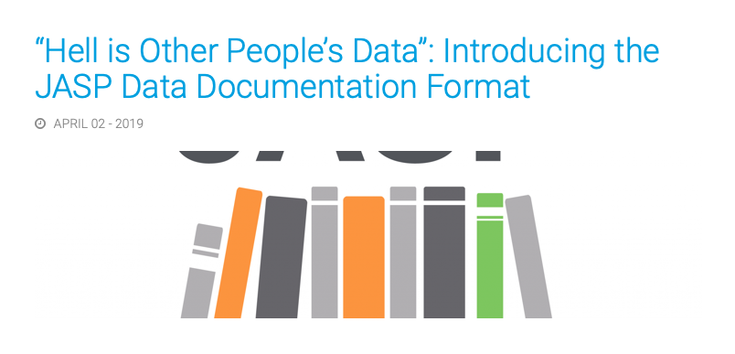
Use Available Resources
Further Topics
Open Data and Open Access
JASP Data Documentation Guidelines
Helpdesks at University Libraries
(in Heerlen: Gjalt-Jorn Peters)
Onderwijs Research Dagen 2019
Alexandra Sarafoglou

Slide 35
Confirmatory versus
Exploratory Analysis
Solutions
Be transparent about your research methods and study design
Specify your hypotheses and your analysis plan before you start data collection
Exchange experiences with peers (e.g., through an Open Science Community)
Start small: incorporate good research practices in your student projects and teaching
Onderwijs Research Dagen 2019
Alexandra Sarafoglou

Slide 36
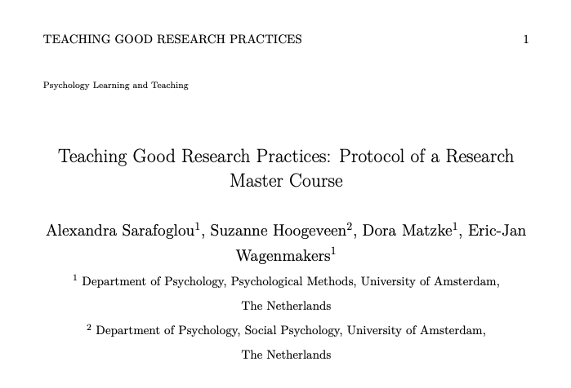
Teaching Good Research Practices
Sarafoglou A., Hoogeveen S., Matzke D., & Wagenmakers, E.-J. (in press). Teaching Good Research Practices: Protocol of a Research Master Course. Preprint available on PsyArXiv: https://psyarxiv.com/gvesh/
Onderwijs Research Dagen 2019
Alexandra Sarafoglou

Slide 37
Open Science:
The Student Experience
Onderwijs Research Dagen 2019
Myrthe Veenman

Slide 38
Open Science:
The Student Experience
Outline
Why?
Supervisor
Teacher
Study Program
Advisor
Challenges
Improvements
Onderwijs Research Dagen 2019
Myrthe Veenman

Slide 39
The Importance of
Open Science in The Study Program
Why?
Why not?
If universities teach students how to do research, then teach them to do research the right way
Researchers of the future
Change the research culture
Publish, publish, publish
Onderwijs Research Dagen 2019
Myrthe Veenman

Slide 40



Open Science:
The Student Experience
The study program
The teacher
The supervisor
The student
Onderwijs Research Dagen 2019
Myrthe Veenman

Slide 41
The Importance of the Supervisor
Open Science Practices in Internship or Thesis
Preregistration
Benefits
Confirmatory versus Exploratory
Feedback from supervisor before analysis
Analysis plan ready before data collection
Onderwijs Research Dagen 2019
Myrthe Veenman

Slide 42
The Importance of the Supervisor
Methodology Shop
Free methodological advice
Students come by with their analysis problems when it is already too late
Come before conducting your analysis to make an analysis plan
Preregistration avoids that students still stress at the end of their project about their analyses
Onderwijs Research Dagen 2019
Myrthe Veenman

Slide 43
The Importance of the Supervisor
Open Science Practices in Internship or Thesis
Preregistration
OSF
Proposal
Open Data
Shared data
Open Code
Open Material
Provided access to material
Onderwijs Research Dagen 2019
Myrthe Veenman

Slide 44
The Importance of the Teacher
Open Science Practices in Courses
Preregistration
Predata report
Either applied or discussed
Onderwijs Research Dagen 2019
Myrthe Veenman

Slide 45
The Importance of the Teacher
Other Open Science Practices in Courses
Share R Code/SPSS syntax
Hand in your code for assignments/projects
Discussed Exploratory versus Confirmatory
Open Material
Material for the course was online
Encouraged to put own assignments/projects online
Onderwijs Research Dagen 2019
Myrthe Veenman

Slide 46
Open Science in The Study Program
Course: Good Research Practices
Students really appreciated the course
They would recommend it to other universities
Some suggested instead to apply the course content in existing courses
Onderwijs Research Dagen 2019
Myrthe Veenman

Slide 47


Open Science in The Study Program
Programming or Not?
Make your analysis reproducible
Different programs that allow for that
R
JASP
University of Glasgow and University of Tübingen teach Psychology students in the Bachelor program R instead of SPSS
Good responses from Glasgow students
Onderwijs Research Dagen 2019
Myrthe Veenman

Slide 48
The Importance of an Advisor
Who to Ask for Help?
Researchers
Professors
Supervisor
Open Science fans
However, most students did not know who to ask exactly
Which researchers/professors?
No general university advisor for students or not aware of the existence
Onderwijs Research Dagen 2019
Myrthe Veenman

Slide 49

Challenges
Time constraints (especially for preregistration)
Onderwijs Research Dagen 2019
Myrthe Veenman

Slide 50
Challenges
Time Constraints
Example of Bachelor Project
Week 1 – 8
Literature research
Study design
Ethical approval, prepare materials, book lab etc.
Introduction, Methods, and Analysis Plan
Create Dummy Data, Analyze Dummy Data, Adjust Analysis Plan (R Code)
One round of Feedback
Week 9 – 12
Data collection
Incorporate feedback for Introduction and Methods part
Week 13 – 16
Analyze Data
Results section and Discussion
Reflection report
Prepare presentation
Onderwijs Research Dagen 2019
Alexandra Sarafoglou

Slide 51
Challenges
Time constraints (especially for preregistration)
Different experiences
Time was not a problem for some
Others felt the time pressure
Some experienced it as time saving in the end
Lack of experience
Never done before themself
Supervisor could not help
Onderwijs Research Dagen 2019
Myrthe Veenman

Slide 52
How Can We Improve the Experience for Students?
Onderwijs Research Dagen 2019
Myrthe Veenman

Slide 53
How Can We Improve the Experience for Students?
Make It Practical!
Onderwijs Research Dagen 2019
Myrthe Veenman

Slide 54
How Can We Improve the Experience for Students?
Make It Practical!
Tutorials, step-by-step instructions
Data Management
Guidelines how to upload/share data (to OSF)
Code styles
Guidelines on how to share experiments
Examples
Let students do it
Onderwijs Research Dagen 2019
Myrthe Veenman

Slide 55
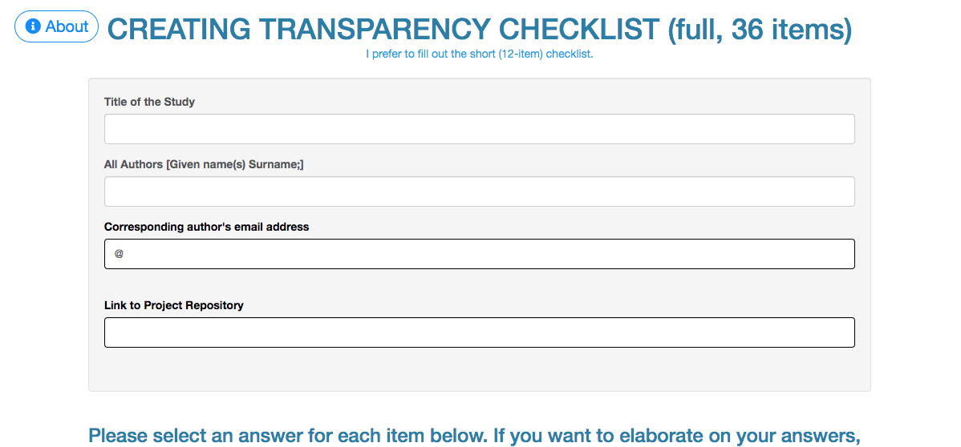
How Can We Improve the Experience for Students?
Make It Practical!
Tutorials, step-by-step instructions
Data Management
Guidelines how to upload/share data (to OSF) and create a README file
Code styles
Guidelines on how to share experiments
Examples
Let students do it
https://eltedecisionlab.shinyapps.io/TransparencyChecklist/
Onderwijs Research Dagen 2019
Myrthe Veenman

Slide 56
How Can We Improve the Experience for Students?
Other Suggestions
An Open Science advisor per university/department
Listing pro Open Science journals
Onderwijs Research Dagen 2019
Myrthe Veenman

Slide 57
How Can We Improve the Experience for Students?
Other Suggestions
An Open Science advisor per university/department
Listing pro Open Science journals
Journals that implement Open Science badges: https://cos.io/our-services/open-science-badges/
Onderwijs Research Dagen 2019
Myrthe Veenman

Slide 58
How Can Teachers Improve the Experience for Students?
Suggestions for Courses
Provide open access to course material
Implement preregistration more (e.g., predata report for final project)
Implement Open Data + data management
Apply Open Science tools, for instance the OSF
Onderwijs Research Dagen 2019
Myrthe Veenman

Slide 59
What Would Students
Like to Learn More About?
Suggestions for Study Programs
Latest techniques in Open Science
Developments in Open Science
For example a seminar once a month
How to apply Open Science in your study
How Open Science can improve your scientific career
Concrete steps for junior researchers
Onderwijs Research Dagen 2019
Myrthe Veenman

Slide 60
What Would Students
Like to Learn More About?
Suggestions for Study Programs
Latest techniques in Open Science
Developments in Open Science
For example a seminar once a month
How to apply Open Science in your study
How Open Science can improve your scientific career
Concrete steps for junior researchers
Onderwijs Research Dagen 2019
Myrthe Veenman

Slide 61
Open Science and Reproducibility
Summary
Confirmatory versus Exploratory Research
Practical Tools to Increase Transparency
Preregistration and Analysis Blinding
Teaching Good Research Practices: Student Perspective
Onderwijs Research Dagen 2019
Alexandra Sarafoglou, Myrthe Veenman

